Slide 1

TIME SERIES FORECASTING USING ARIMA
Dataset consists of 1781 rows and 10 columns and covers the period from 1st Jan’16 to 15th Nov’20. We drop 8 columns and keep only 2 columns namely ‘datetime’ and ‘temp’.
Objective: To forecast the temperature for the city of Mumbai
Data cleaning: Formatted the ‘month’ column by using “lubridate” package and converted it to a date vector from character vector. There was no missing data.

Slide 2
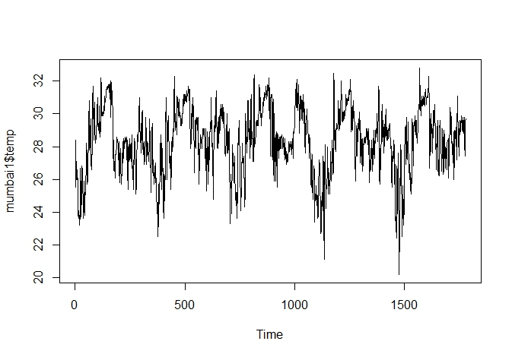
STATIONARY DATA
We run libraries (forecast, tseries)
ARIMA model works with only stationary data. This means the mean and variance should be constant over time. We plot the data and it looks like the data is stationary

Slide 3
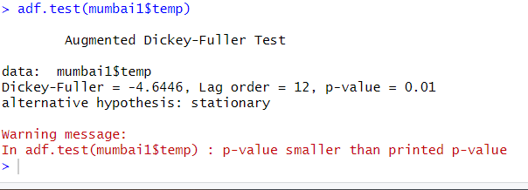
STATIONARY DATA
One way to check if the data is stationary is to use the ADF Test (Augmented Dickey-Fuller). If the p value is less than that of alpha (0.05), then the data is stationary. We find the p value to be 0.01, so we can say that the data is stationary.

Slide 4
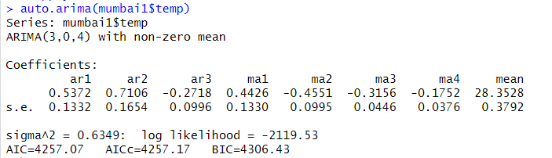
ARIMA (AUTO REGRESSIVE INTEGRARED MOVING AVERAGE)
We use the auto.arima function to best fit the ARIMA model
ARIMA (3,0,4) indicates 3 (p) = number of periods to lag, 0(d) = differencing, 4 (q) = lag of the error component
We create the model using the arima function and the pdq (3,0,4) values

Slide 5
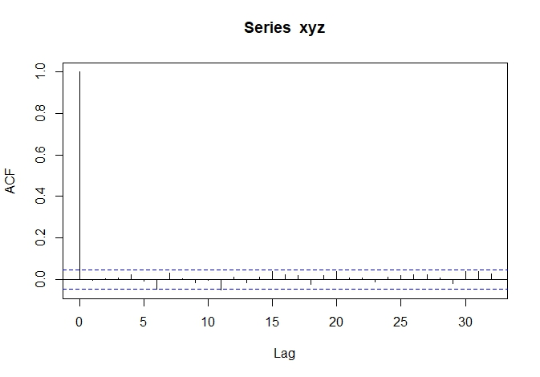
DIAGNOSTIC CHECK
We run Diagnostic check options to check the residuals. Basically it means what is left over after fitting the model. Residuals are important to check if the model has adequately captured the data or not.
We use the ‘acf’ (Auto Correlation function) to check for any correlation amongst the residuals. When the black bar crosses the blue line, there is correlation. We find this happening around lag 6. From lag 0 to 5, there is no correlation.

Slide 6
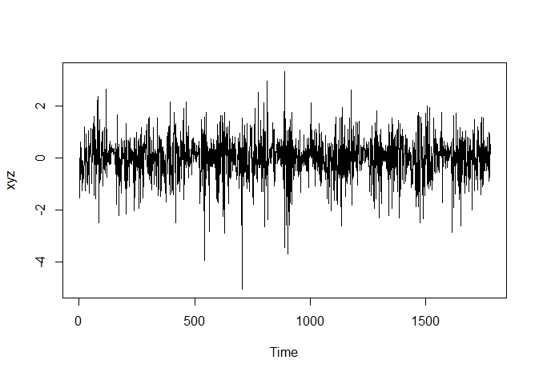
DIAGNOSTIC CHECK
Plot indicates the mean is constant at 0.

Slide 7
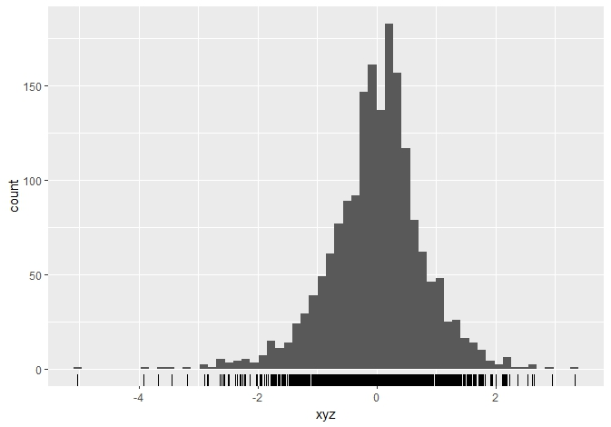
DIAGNOSTIC CHECK
We use ‘gghistogram’ function which indicates that the residuals are normally distributed as indicated by the bell shape

Slide 8
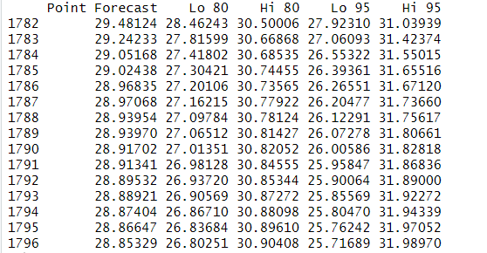
FORECASTING
We will forecast the temperature values for 15 days ranging from 16th Nov’20 to 30th Nov’20 using the ‘forecast’ function. We get the forecasted temperature at higher and lower confidence levels of 80% and 95% as well.

Slide 9
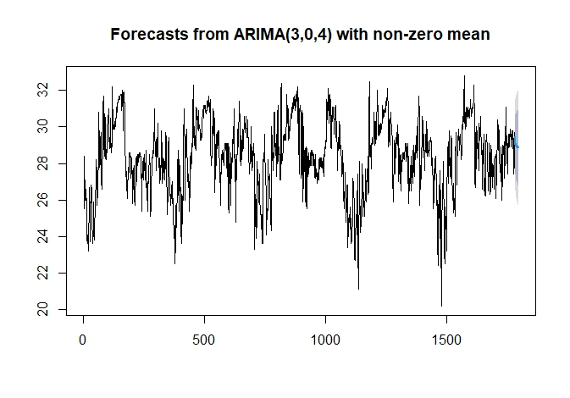
PLOT THE FORECAST
Y axis denotes the temperature values and the x axis denotes the days. For eg 500th day, 1000th day. Blue line at the extreme right near the 28 value of the Y axis is the forecasted or predicted value of the temperature for the 15 days. Dark grey shaded area is the upper and lower confidence level at 80% and the light grey shaded area is the upper and lower confidence at 95%.

Slide 10
ACTUAL VS PREDICTED COMPARISON
We can also compare the actual vs predicted temperature for the last 5 days (from 11th Nov’20 to 15th Nov’20). As we can see there is a very minimal difference between the predicted and actual values
RMSE is 0.795, MAPE is 2.11 (accuracy is 97.89%), MAE is 0.587 which means that the predicted value deviates from the actual value only by 0.587. We can say that the model is significant.
Date | Predicted Temperature | Actual Temperature | Difference
11-Nov-20 | 28.08733 | 27.4 | 0.68733
12-Nov-20 | 28.32768 | 28 | 0.32768
13-Nov-20 | 28.63083 | 28.4 | 0.23083
14-Nov-20 | 28.69809 | 29.5 | -0.80191
15-Nov-20 | 28.74088 | 29.7 | -0.95912

